Slide 1
ARCACHON FRANCE
Saint Thomas School

Slide 2
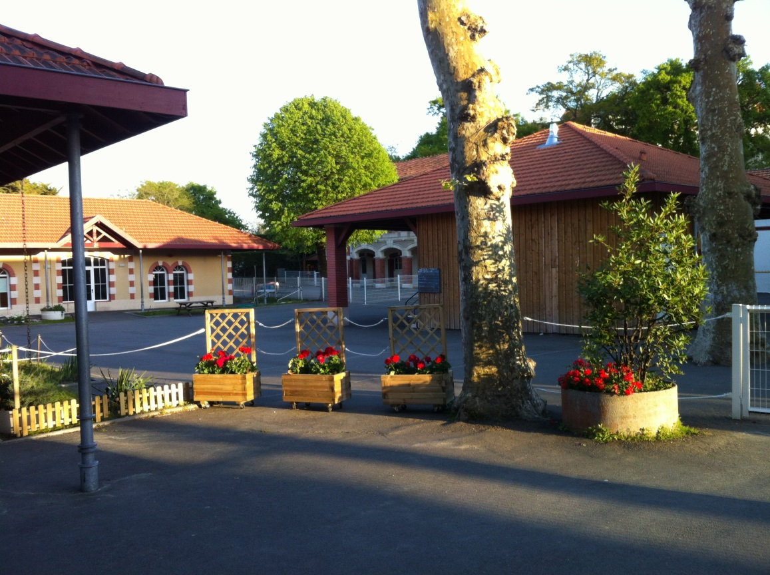
Our school

Slide 3
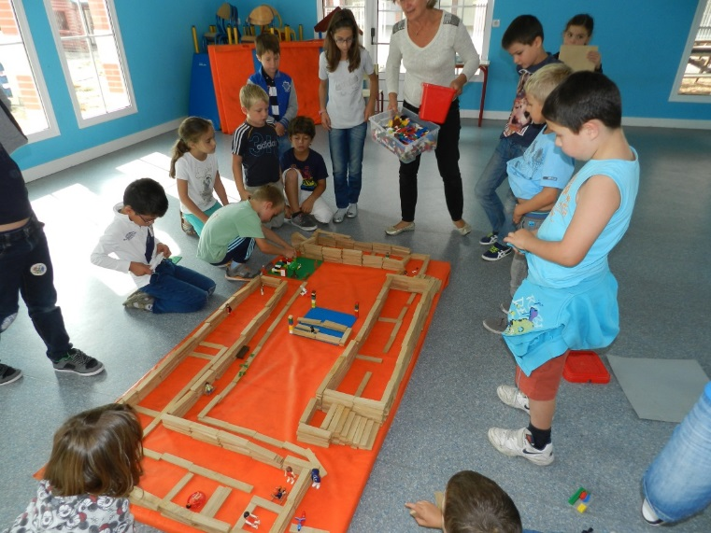
Where are windows and doors ??

Slide 4
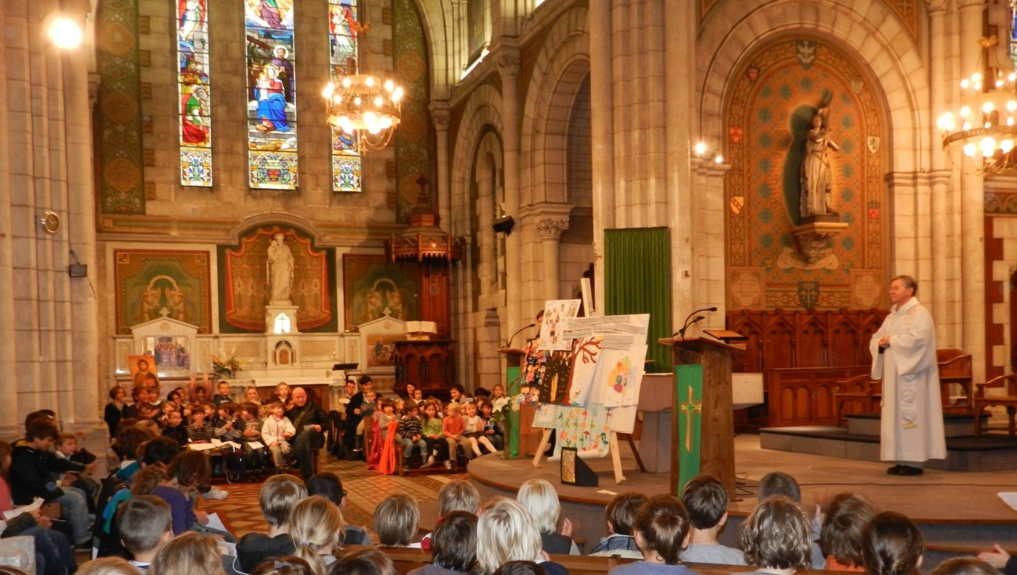
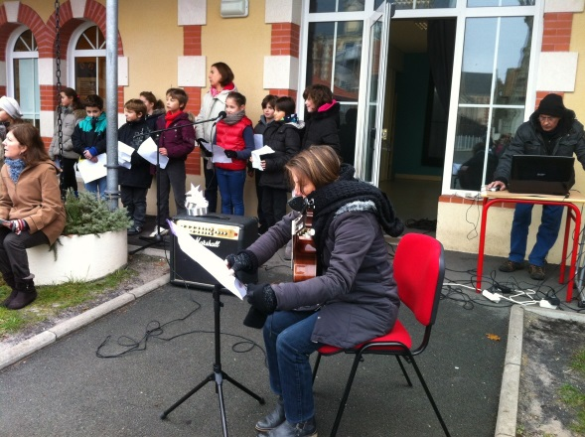
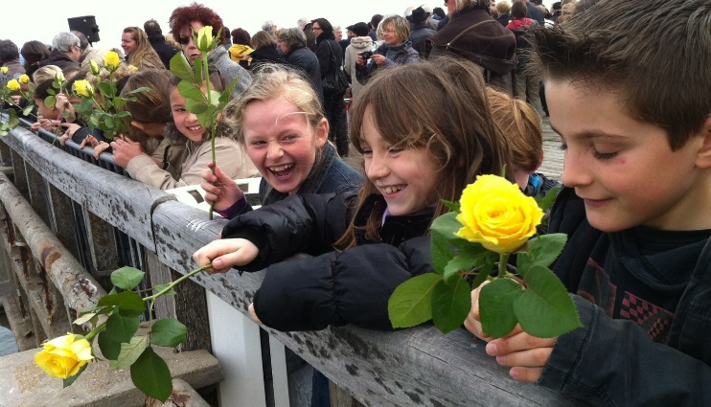
We are a Catholic school where it is very pleasant to live and learn

Slide 5
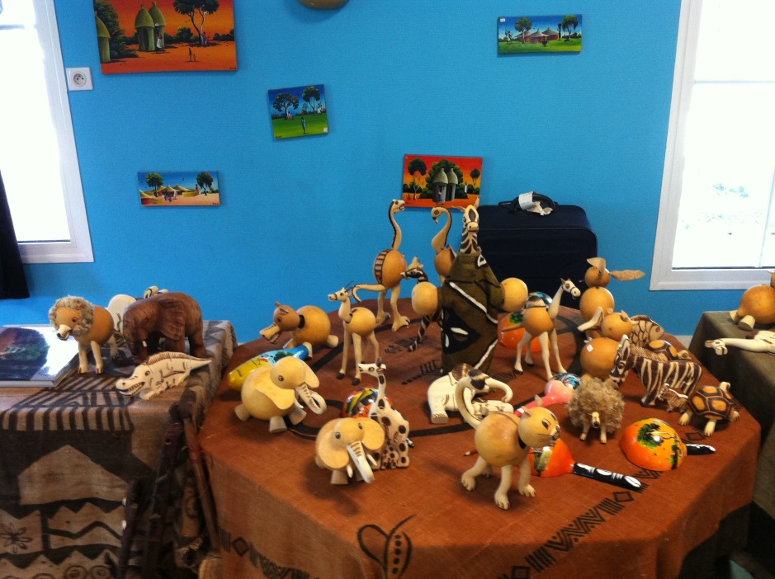
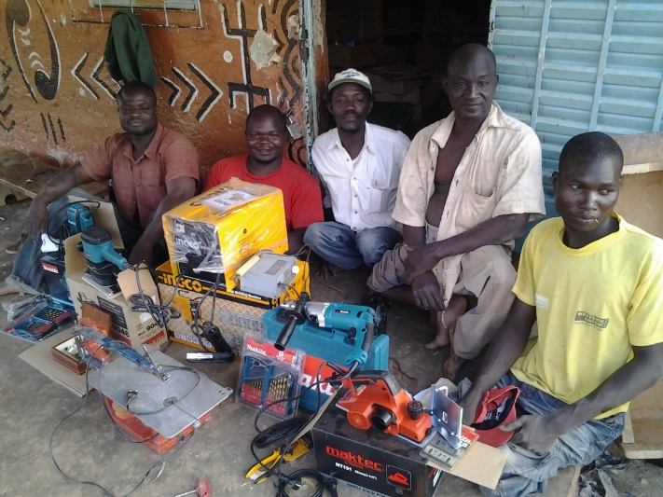
For our friends who live in Burkina Faso, we organize charity sales so they buy tool

Slide 6
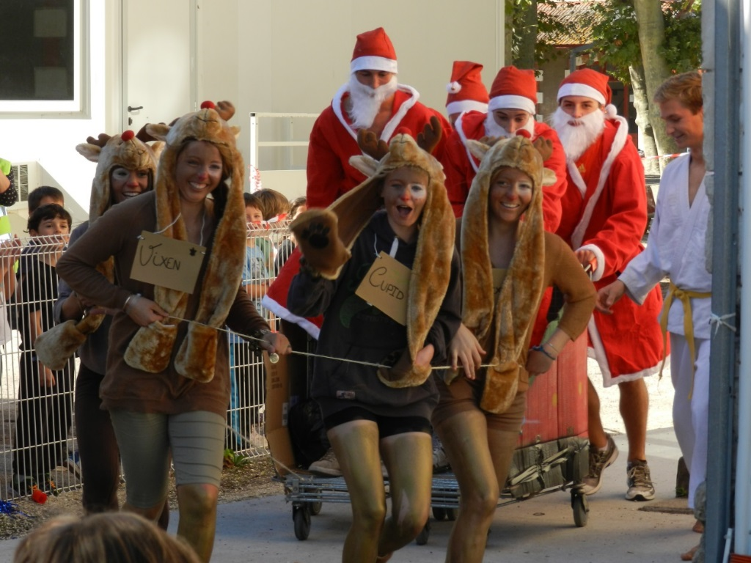
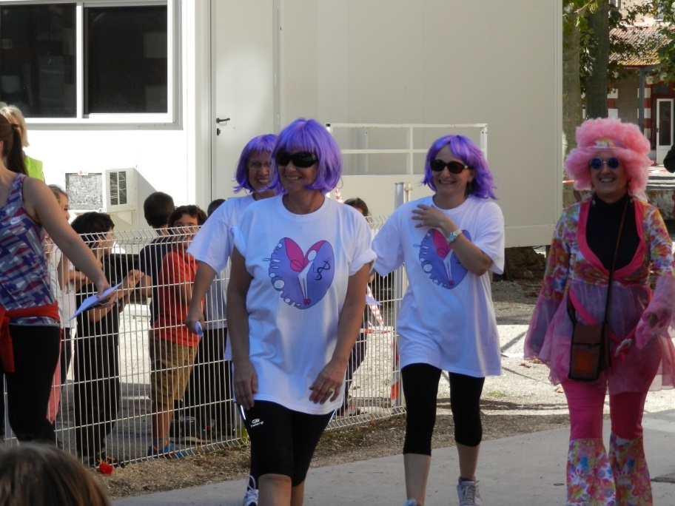
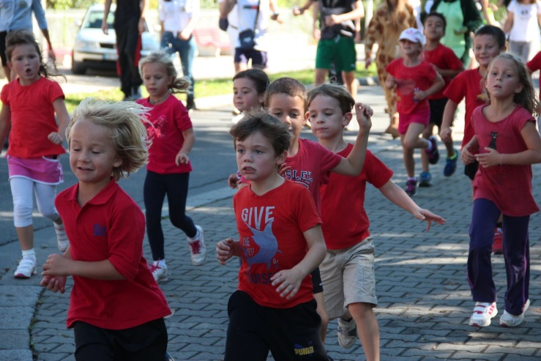
Crazy time to fight a crazy disease: cancer.
We run !!

Slide 7
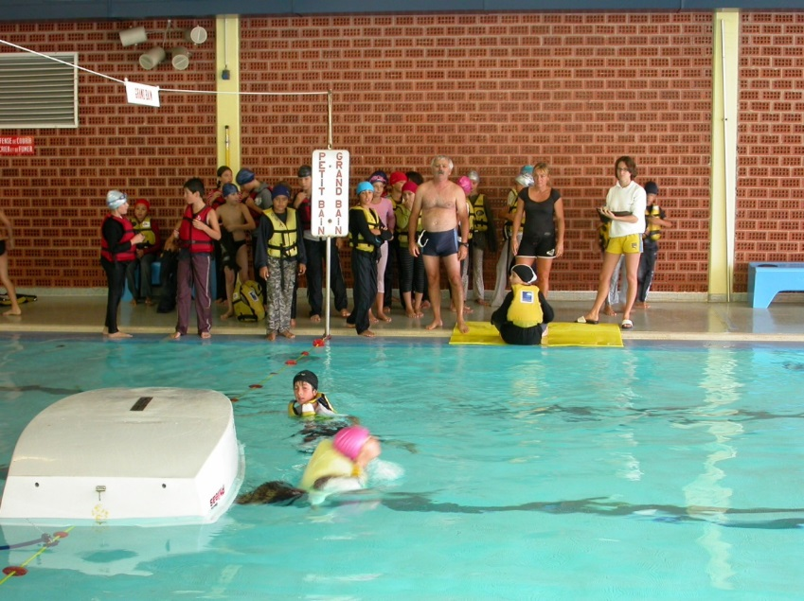
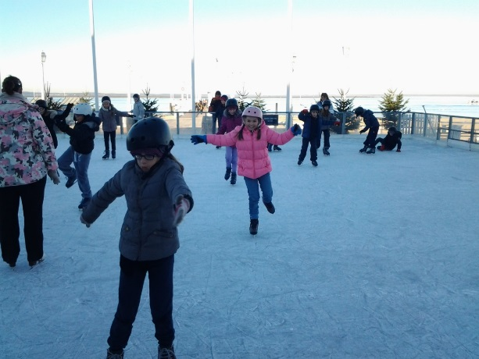
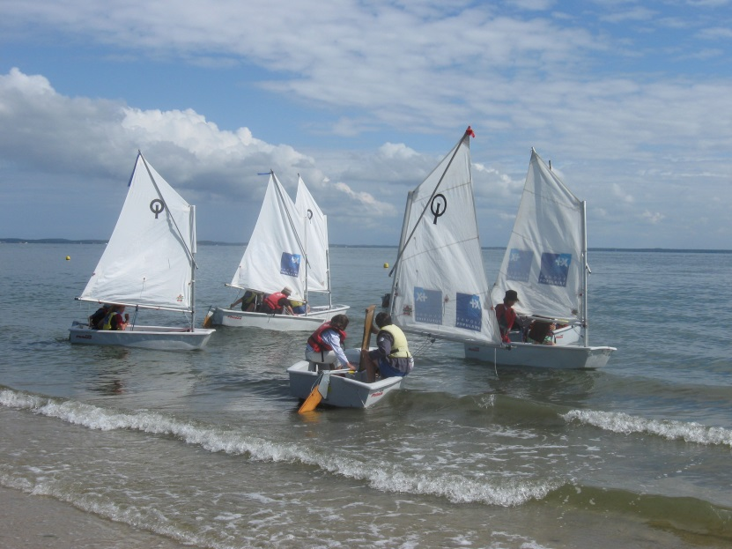
Throughout the year, we practice a variety of sports.

Slide 8
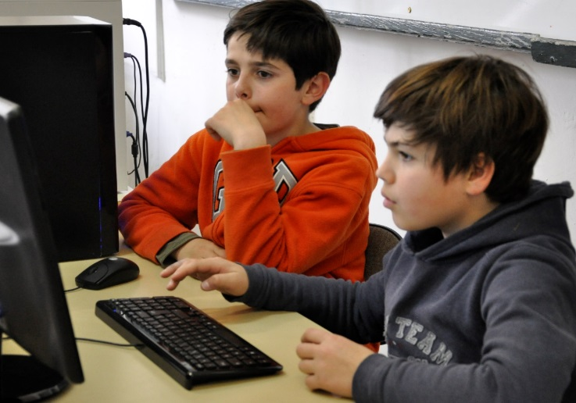
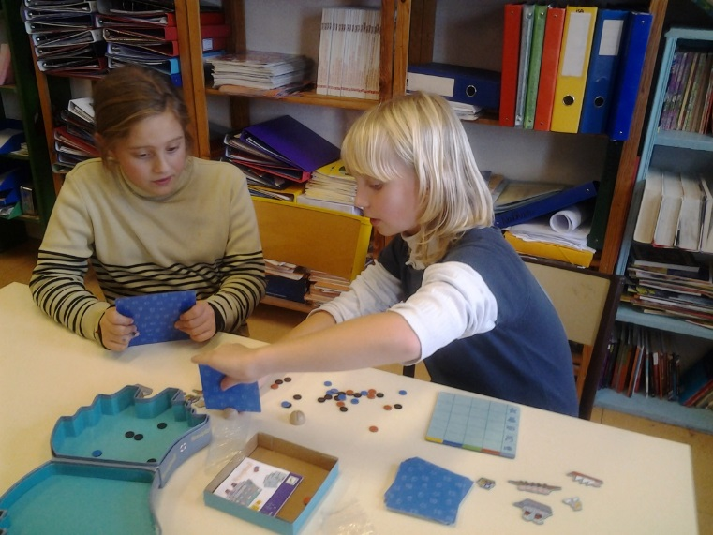
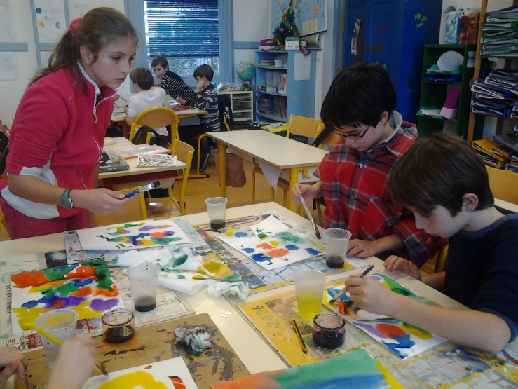
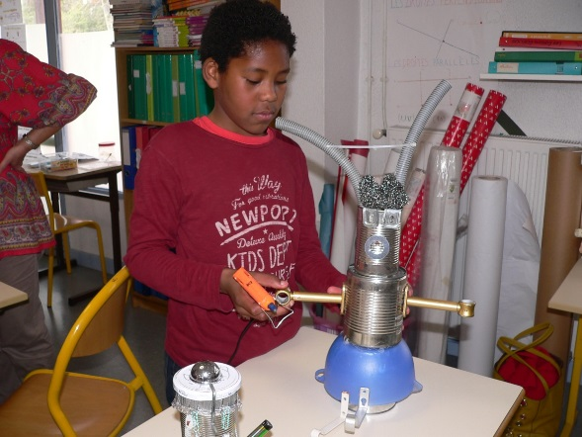
Of course, not to get bored, we also work a little…sometimes !

Slide 9
Inside.
Or outside.

Slide 10
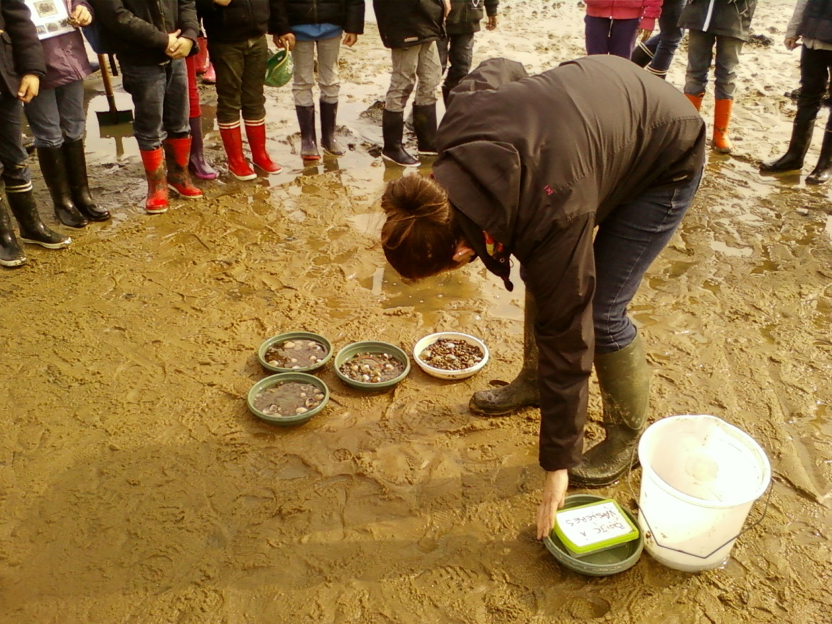
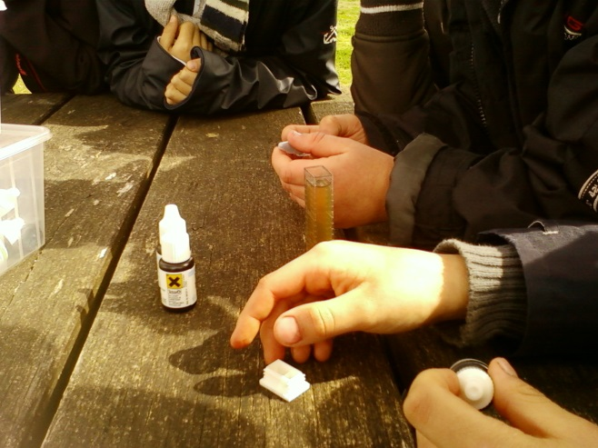

Slide 11
In French.
Or in English.

Slide 12
But always smiling !

Slide 13
and always ready for new adventures !

Slide 14
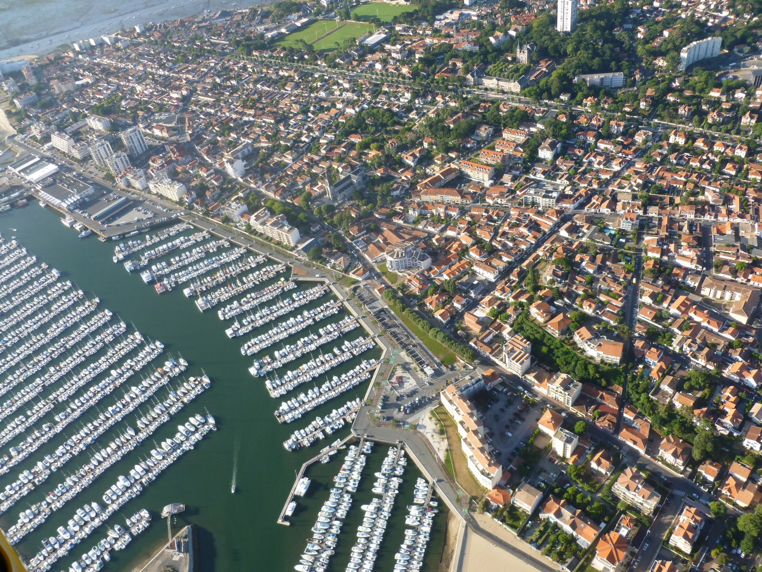
Our town, Arcachon
A small fishermen town

Slide 15
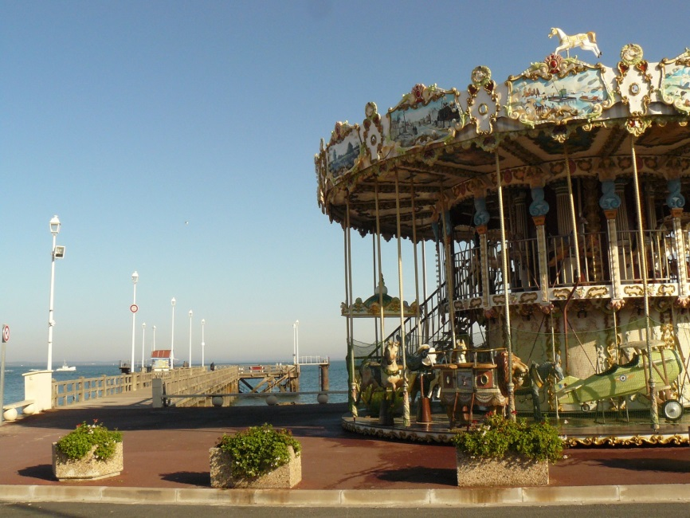
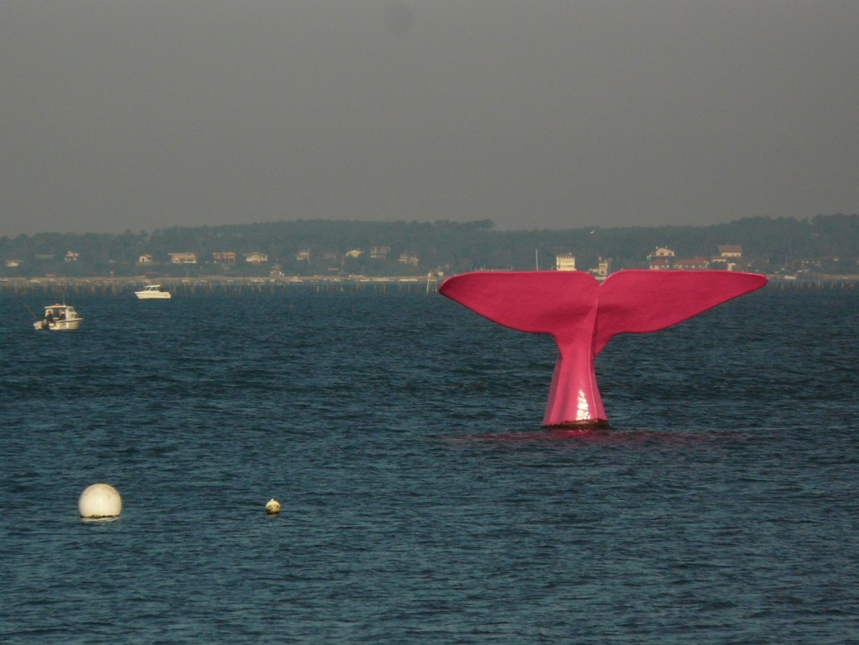
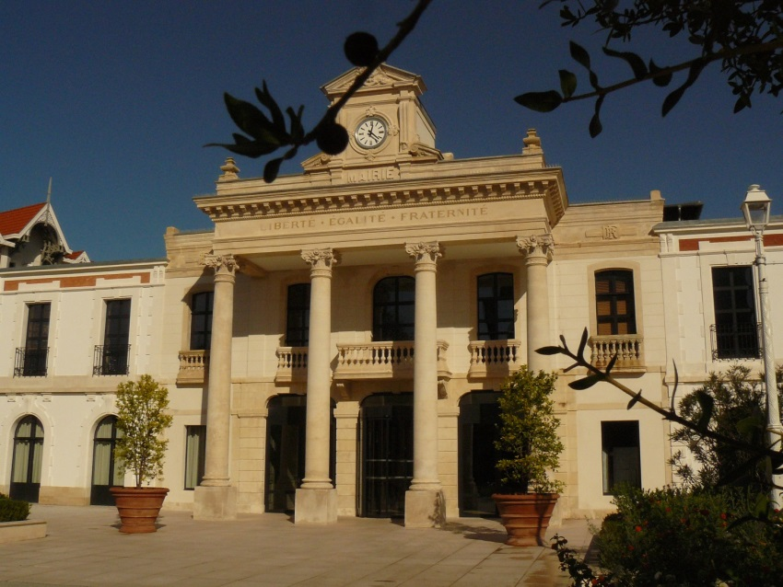
Today, the Arcachon basin is one of the most visited tourist sites of Aquitaine.

Slide 16
See you soon in Arcachon!

